Slide 1


Evangelos Charalampopoulos
11th October 2024

Slide 2

Outline
Executive Summary
Introduction
Methodology
Results
Conclusion
Appendix

Slide 3
Executive Summary
Summary of methodologies
Logistic Regression
Support Vector Machine
Decision Tree
K-Nearest Neighbors
Logistic Regression has the highest classification Accuracy
Summary of all results
Launch Success rate over 60% since 2016
First successful landing on a ground pad at 12/12/2015
Successful missions: 60
Failed missions: 30
KSC LC-39A is the site with the highest success rate

Slide 4
Introduction
Prediction if the Falcon 9 first stage will land successfully.
SpaceX advertises Falcon 9 rocket launches on its website with a cost of 62 million dollars; other providers cost upward of 165 million dollars each, much of the savings is because SpaceX can reuse the first stage.
If we can determine if the first stage will land, we can determine the cost of a launch.
This information can be used if an alternate company wants to bid against SpaceX for a rocket launch.

Slide 5

Section 1

Slide 6
Methodology
Executive Summary
Data collection methodology:
Data have been retrieved from SpaceX API
Perform data wrangling
Removing of “Falcon 1 launches” keeping only the Falcon 9 launches.
Reset the FlightNumber column
Dealing with Missing Values
Perform exploratory data analysis (EDA) using visualization and SQL
Perform interactive visual analytics using Folium and Plotly Dash
Perform predictive analysis using classification models
Model Selection, Training, Tuning, Evaluation, Interpretation, Deployment

Slide 7
Data Collection
Request to the SpaceX API (https://api.spacexdata.com/v4/)
Web scraping to collect Falcon 9 historical launch records from a Wikipedia page

Slide 8
Data Collection – SpaceX API
Get request to the SpaceX API
Clean the requested data
Create a dataframe
Filter the dataframe to only include Falcon 9 launches
Dealing with Missing Values
GitHub URL: https://github.com/xaralabo/falcon/blob/main/jupyter-labs-spacex-data-collection-api.ipynb

Slide 9
Data Collection - Scraping
Web scraping to collect Falcon 9 historical launch records from a Wikipedia page
Launch records are stored in a HTML table
Extract Falcon 9 launch records HTML table from Wikipedia using BeautifulSoup
Extract all column/variable names from the HTML table header
Parse the table and convert it into a Pandas data frame
Export to a CSV file
GitHub URL: https://github.com/xaralabo/falcon/blob/main/jupyter-labs-webscraping.ipynb

Slide 10
Data Wrangling
Sequentially the following flow:
Data Collection
Data Cleaning
Data Transformation
Data Validation
Save Cleaned Data
GitHub URL: https://github.com/xaralabo/falcon/blob/main/labs-jupyter-spacex-Data%20wrangling.ipynb

Slide 11
EDA with Data Visualization
Charts for Visualization
Scatter plot of Flight Number vs. Launch Site
Scatter plot of Payload vs. Launch Site
Bar Graph of Payload vs. Launch Site
Scatter Plot of Flight number vs. Orbit type
Scatter plot of payload vs. orbit type
Linear Graph with success Yearly Trend
GitHub: https://github.com/xaralabo/falcon/blob/main/jupyter-labs-eda-sql-coursera_sqllite.ipynb
Add the GitHub URL of your completed EDA with data visualization notebook, as an external reference and peer-review purpose

Slide 12
EDA with SQL
%sql select DISTINCT(Launch_Site) from SPACEXTABLE
%sql select * from SPACEXTABLE WHERE Launch_Site LIKE 'CCA%' LIMIT 5
%sql select sum() from SPACEXTABLE where Customer='NASA (CRS)’
%sql select avg(PAYLOAD_MASS__KG_) from SPACEXTABLE where Booster_Version LIKE 'F9 v1.1’
%sql select min(Date) from SPACEXTABLE where Landing_Outcome='Success’
%sql select Booster_Version from SPACEXTABLE where Booster_Version='Success’
%sql select Mission_Outcome, count(*) from SPACEXTABLE group by Mission_Outcome
%sql select DISTINCT(Booster_Version) from SPACEXTABLE where PAYLOAD_MASS__KG_=(select max(PAYLOAD_MASS__KG_) from SPACEXTABLE)
%sql select substr(Date, 6,2), Landing_Outcome, Booster_Version, Launch_Site from SPACEXTABLE where substr(Date,0,5)='2015’
%sql select Landing_Outcome, count(*) from SPACEXTABLE where date >= '2010-06-04' and date <= '2017-03-20' group by Landing_Outcome
GitHub: https://github.com/xaralabo/falcon/blob/main/jupyter-labs-eda-sql-coursera_sqllite.ipynb

Slide 13
Build an Interactive Map with Folium
All site's location have been added on a map using site's latitude and longitude coordinates
Highlighted circle area with a text label for each location
GitHub: https://github.com/xaralabo/falcon/blob/main/lab_jupyter_launch_site_location.ipynb

Slide 14
Build a Dashboard with Plotly Dash
Pie chart with the total successful launches count for all sites
Scatter chart for the correlation between payload and launch success
GitHub: https://github.com/xaralabo/falcon/blob/main/spacex_dash_app.py

Slide 15
Predictive Analysis (Classification)
Problem Definition and Data Understanding
Model Selection (Logistic Regression, Decision Trees, SVM, k-Nearest Neighbors)
Data Splitting: Divided the dataset into training and testing sets
Model Training: Trained each model on the training data and used basic evaluation metrics like accuracy to assess initial performance.
Model Comparison: Analyzed metrics beyond accuracy and confusion matrices
Model Testing and Deployment
GitHub: https://github.com/xaralabo/falcon/blob/main/SpaceX_Machine%20Learning%20Prediction_Part_5.ipynb

Slide 16
Results
Launch Success rate over 60% since 2016
First successful landing on a ground pad at 12/12/2015
Successful missions: 60
Failed missions: 30
KSC LC-39A is the site with the highest success rate
Logistic Regression Model has the highest classification Accuracy

Slide 17

Section 2

Slide 18
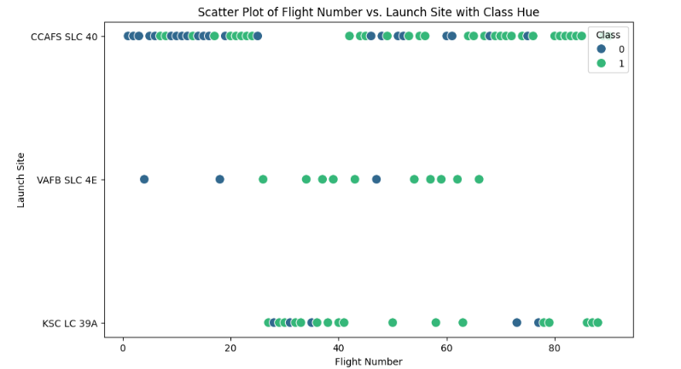
Flight Number vs. Launch Site
Scatter plot of Flight Number vs. Launch Site
FlightNumber (indicating the continuous launch attempts.)
Blue and Green Colors indicate the Class Hue

Slide 19
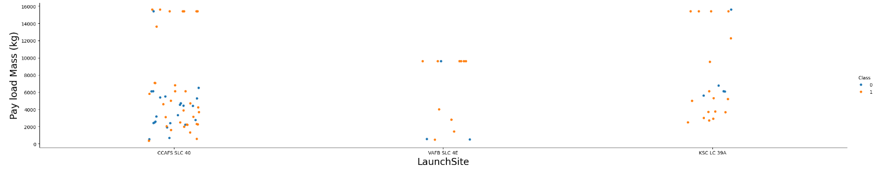
Payload vs. Launch Site
Scatter plot of Payload vs. Launch Site
First Launch Site has the most cases
Blue and orange colors indicate the class

Slide 20
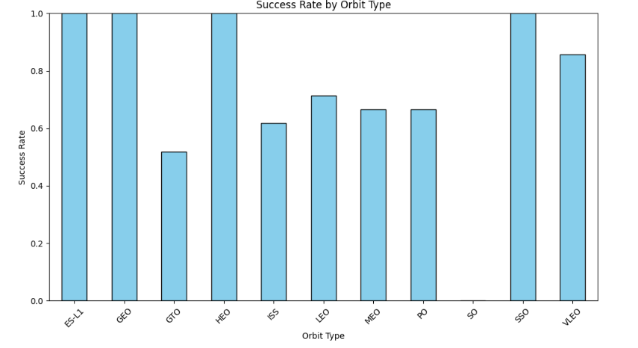
Success Rate vs. Orbit Type
Four Orbit Types have the highest Success Rate
SO hasn’t any success rate

Slide 21
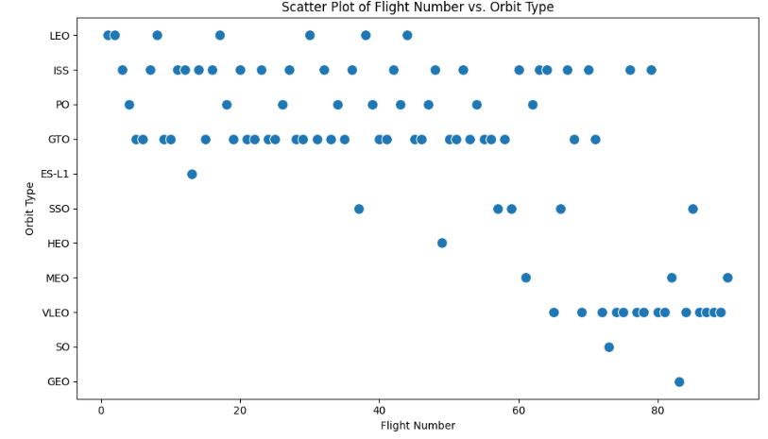
Flight Number vs. Orbit Type
Scatter Plot of Flight number vs. Orbit type

Slide 22
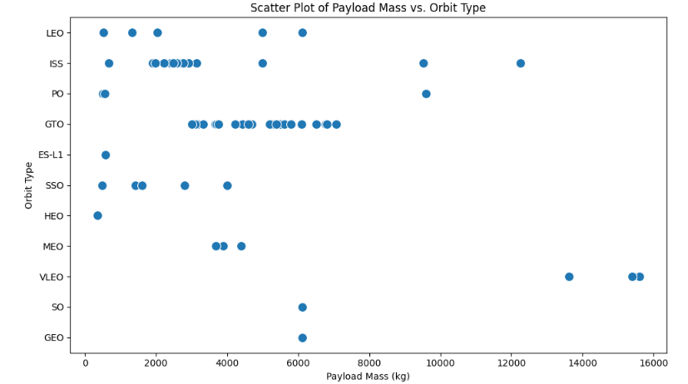
Payload vs. Orbit Type
Scatter plot of payload vs. orbit type
GTO hasn’t outlier values

Slide 23
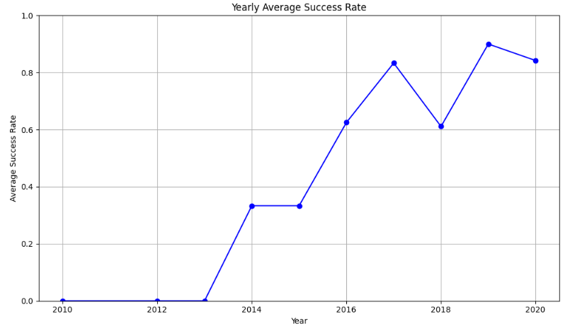
Launch Success Yearly Trend
Zero success rate till 2013
Success rate over 60% since 2016

Slide 24
All Launch Site Names
Lanch Site Names
CCAFS SLC 40
VAFB SLC 4E
KSC LC 39A
Code
unique_launch_sites = df['LaunchSite'].unique()
print("Unique Launch Sites:")
print(unique_launch_sites)

Slide 25
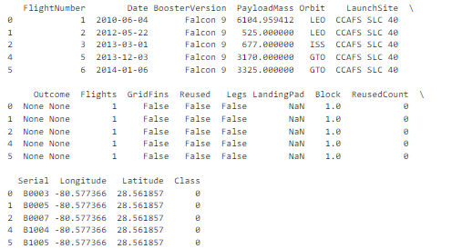
Launch Site Names Begin with 'CCA'
Code
filtered_records = df[df['LaunchSite'].str.startswith('CCA', na=False)]
print(filtered_records.head(5))

Slide 26
Total Payload Mass
Total payload carried by boosters from NASA
549446.3470588236 kg
Code
total_payload_mass = df['PayloadMass'].sum()
print(f"Total Payload Mass Carried by Boosters: {total_payload_mass} kg")

Slide 27
Average Payload Mass by F9 v1.1
Average Payload Mass Carried by Booster Version F9 v1.1: nan kg
Code
f9_v1_1_payloads = df[df['BoosterVersion'] == 'F9 v1.1’]
massaverage_payload_mass = f9_v1_1_payloads['PayloadMass'].mean()
print(f"Average Payload Mass Carried by Booster Version F9 v1.1: {average_payload_mass} kg")

Slide 28
First Successful Ground Landing Date
Date of the first successful landing on a ground pad:
2015-12-22
Code
ground_pad_success = df[df['LandingPad'].notna() & (df['Class'] == 1)]
first_success_date = ground_pad_success['Date'].min()
print(f"Date of the first successful landing on a ground pad: {first_success_date}")

Slide 29
Successful Drone Ship Landing with Payload between 4000 and 6000
Falcon 9 has been landed successfully
Code
filtered_boosters = df[
df['LandingPad'].notna() & # Ensures LandingPad is not NaN
(df['Class'] == 1) & # Successful landings (Class == 1)
(df['PayloadMass'] > 4000) & (df['PayloadMass'] < 6000) # Payload mass between 4000 and 6000
]
unique_boosters = filtered_boosters['BoosterVersion'].unique()
print("Boosters that successfully landed on a drone ship with specified LandingPad and payload mass between 4000 and 6000 kg:")
print(unique_boosters)

Slide 30
Total Number of Successful and Failure Mission Outcomes
Total number of successful missions: 60
Total number of failed missions: 30
Code:
outcome_counts = df['Class'].value_counts()
print("Total number of successful missions:", outcome_counts.get(1, 0))
print("Total number of failed missions:", outcome_counts.get(0, 0))

Slide 31
Boosters Carried Maximum Payload
Falcon 9 has carried the maximum payload mass
Code
max_payload_mass = df['PayloadMass'].max()
boosters_with_max_payload = df[df['PayloadMass'] == max_payload_mass]['BoosterVersion'].unique()
print(f"The booster(s) that carried the maximum payload mass of {max_payload_mass} kg:")
print(boosters_with_max_payload)

Slide 32
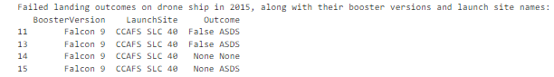
2015 Launch Records
Failed landing in drone ship for in year 2015
Code
df['Date'] = pd.to_datetime(df['Date'])
failed_drone_ship_landings_2015 = df[
(df['Date'].dt.year == 2015) & # Filter for year 2015
(df['Class'] == 0) # Filter for failed outcomes (Class == 0)
]
result = failed_drone_ship_landings_2015[['BoosterVersion', 'LaunchSite', 'Outcome']]
print("Failed landing outcomes on drone ship in 2015, along with their booster versions and launch site names:")
print(result)

Slide 33
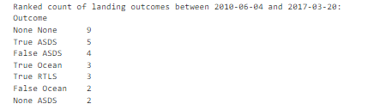
Rank Landing Outcomes Between 2010-06-04 and 2017-03-20
Code
df['Date'] = pd.to_datetime(df['Date'])
filtered_data = df[(df['Date'] >= '2010-06-04') & (df['Date'] <= '2017-03-20')]
landing_outcome_counts = filtered_data['Outcome'].value_counts()
landing_outcome_counts_sorted = landing_outcome_counts.sort_values(ascending=False)
print("Ranked count of landing outcomes between 2010-06-04 and 2017-03-20:")
print(landing_outcome_counts_sorted)

Slide 34

Section 3

Slide 35
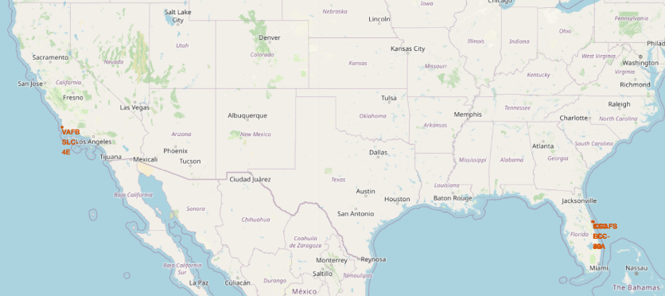
All Launch Sites

Slide 36
Launch outcomes on the map

Slide 37
Map

Slide 38

Section 4

Slide 39
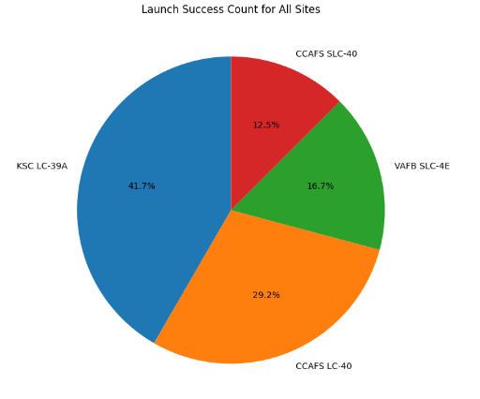
Launch Success Count for all sites
KSC LC-39A has the highest success rate
CCAFS SLC-40 has the lowest success rate

Slide 40
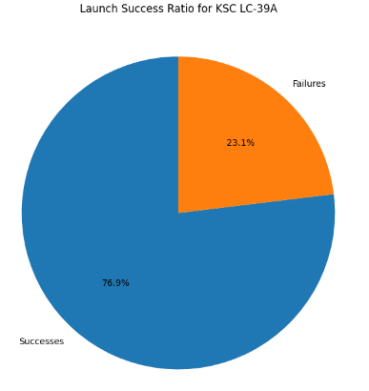
Statistics for KSC LC-39A
KSC LC-39A is the site with the highest success rate

Slide 41
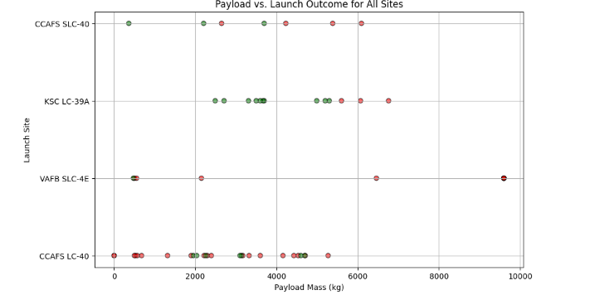
Payload vs Launch Outcome

Slide 42

Section 5

Slide 43
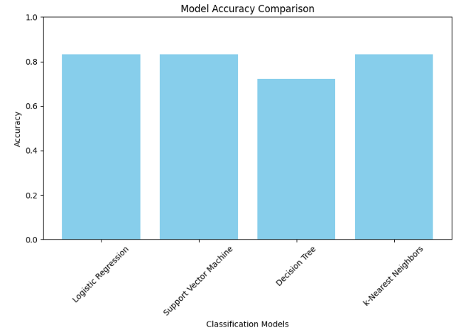
Classification Accuracy
Logistic Regression Model has the highest classification Accuracy

Slide 44
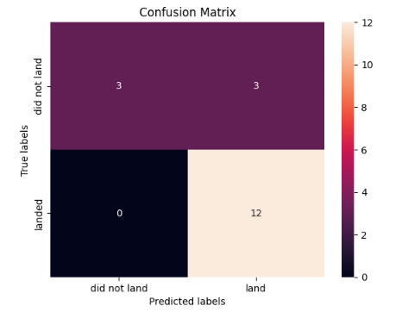
Confusion Matrix
Confusion matrix of the best performing model (Logistic Regression)
Examining the confusion matrix, we see that logistic regression can distinguish between the different classes. We see that the problem is false positives.
True Positive - 12 (True label is landed, Predicted label is also landed)
False Positive - 3 (True label is not landed, Predicted label is landed)

Slide 45
Conclusions
Launch Success rate over 60% since 2016
First successful landing on a ground pad at 12/12/2015
Successful missions: 60
Failed missions: 30
KSC LC-39A is the site with the highest success rate

Slide 46
Appendix
Python Libraries/Packages that were used:
numpy
pandas
seaborn
matplotlib
sklearn
requests
piplite

Slide 47


